Slide 1
Game Rating Prediction
By
G.Chaithanya Kumar

Slide 2
Agenda
Problem Statement
Project Flow
Data collection
Preprocessing
First Data-Frame
Outliers
Second Data-Frame
Feature Enginnering
Third Data-Frame
Merits
De-Merits

Slide 3
Problem Statement
The dataset consists of chess game records, including details such as player ratings, opening moves, game duration, and the game's winner.
The objective is to develop a predictive model that can accurately classify the outcome of a chess game as either a win for white, a win for black, based on the given features.

Slide 4
Flow Chart
Data collection
Data Preprocessing
Data Frame 1
Outliers
EDA
Dara Frame 2
Feature Selection
Data Frame 3

Slide 5
Data Collection
The dataset contains 20058 rows and 16 columns
It has 4 columns consist of numerical and 9 categorical data and 3 non categorical data.
Target Column(winner) is categorical so,I perform classification Machine Learning Algorithm.

Slide 6
Preprocessing
Missing value treatment
Data type conversion
Duplicate checking

Slide 7
DATA FRAME 1
S.No | MODEL_NAME | Accuracy | FPR | TPR | F1-SCORE
0 | log | 50.423729 | 1.000000 | 1.000000 | 0.670423
1 | dt | 62.711864 | 0.374560 | 0.626298 | 0.628005
2 | rf | 69.591226 | 0.294118 | 0687098 | 0.500251
3 | svc | 49.775673 | 0.487179 | 0.493327 | 0.500251
4 | knn | 50.299103 | 0.919558 | 0.908057 | 0.645808
5 | adaboost | 63.334995 | 0.378582 | 0.626792 | 0.627102
6 | xgboost | 87.188435 | 0.131724 | 0.875433 | 0.873274

Slide 8
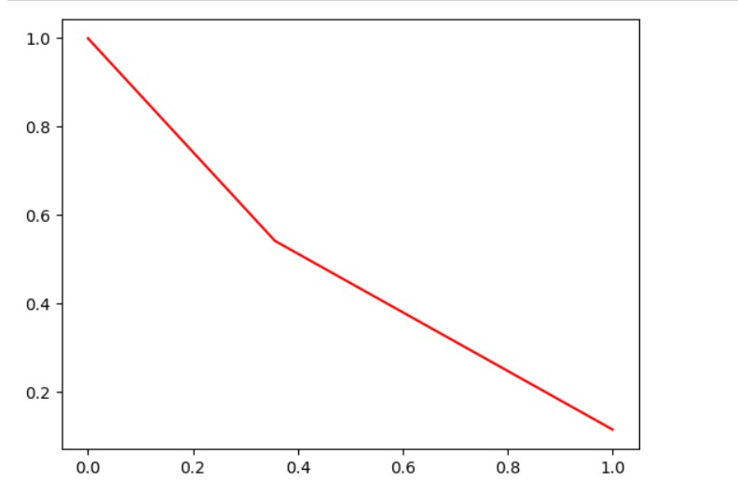
Conclusion for Data Frame 1
In data frame 1 have XGboost achieves the highest accuracy of 87.188435 with a false positive rate (FPR) of 0.13 and true positive rate (TPR) of 0.873
Result of PRC curve

Slide 9
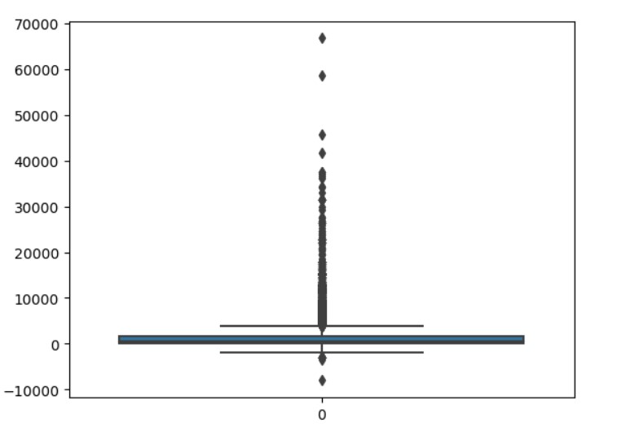
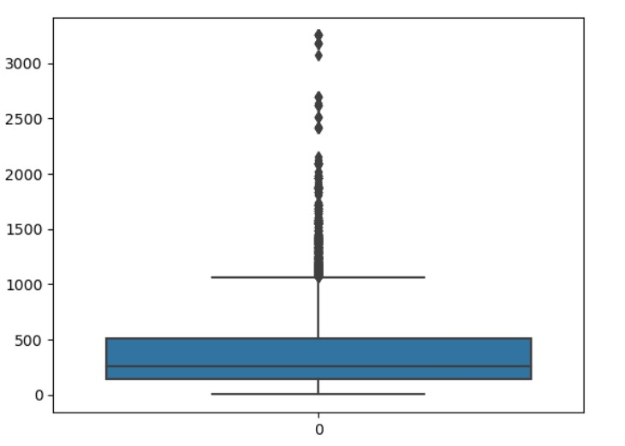
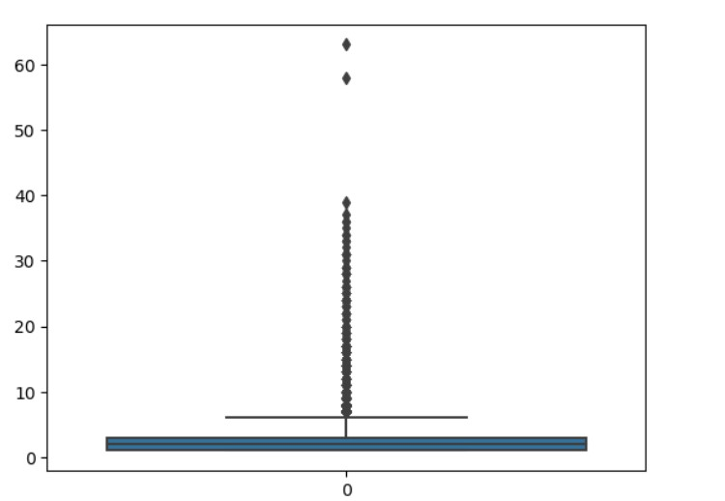
Outlier Treatment
OUTLIER
Box Plot For Outlier in data
Turns
White rating
Black rating

Slide 10
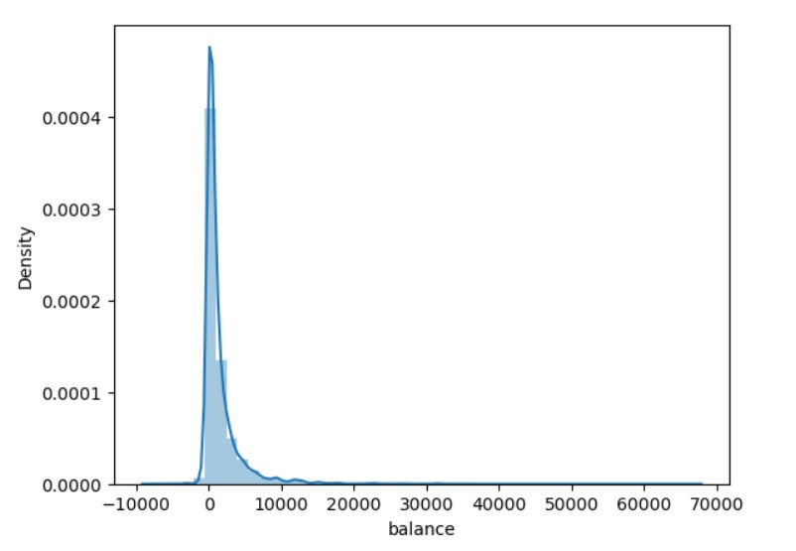
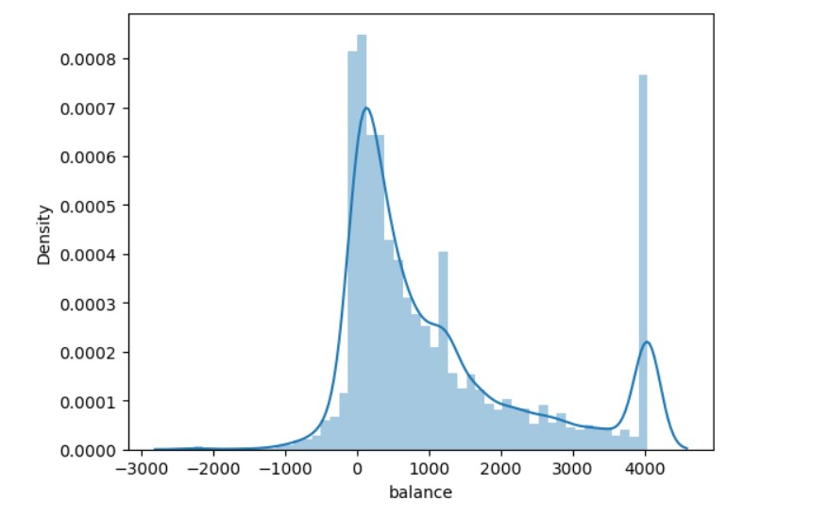
SKEWNESS
White and Black rating
Before
After

Slide 11
DATA FRAME 2
S.No | MODEL_NAME | Accuracy | FPR | TPR | F1-SCORE
0 | log | 49.490430 | 1.000000 | 1.000000 | 0.662122
1 | dt | 74.596073 | 0.198819 | 0.693621 | 0.731462
2 | rf | 79.741486 | 0.194390 | 0.796082 | 0.798288
3 | svc | 50.111857 | 1.000000 | 1.000000 | 0.662122
4 | knn | 54.436987 | 0.432579 | 0.519839 | 0.530090
5 | adaboost | 75.192642 | 0.199803 | 0.698644 | 0.734424
6 | xgboost | 89.833458 | 0.078248 | 0.885987 | 0.901380

Slide 12
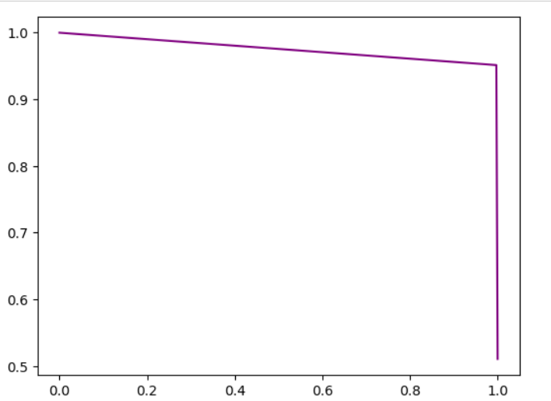
Conclusion for Data Frame 2
In data frame 2 have Xg boost achieves the highest accuracy of 89.33 with a false positive rate (FPR) of 0.0782 and true positive rate (TPR) of 0.8859
Result of PRC curve

Slide 13
Feature Engineering
Perform Recursive Feature Elimination
Dataset having 16 column in that only 6 column selected as a importance feature which are significant.

Slide 14
DATA FRAME 3
S.No | MODEL_NAME | Accuracy | FPR | TPR | F1-SCORE
0 | log | 50.423729 | 1.000000 | 1.000000 | 0.538967
1 | dt | 68.793619 | 0.308698 | 0.687593 | 0.690665
2 | rf | 67.273180 | 0.292107 | 0.632724 | 0.671563
3 | svc | 49.775673 | 0.919558 | 0.908057 | 0.645808
4 | knn | 50.423729 | 0.495224 | 0.503707 | 0.506084
5 | adaboost | 69.217348 | 0.312217 | 0.691547 | 0.692060
6 | xgboost | 88.534397 | 0.114128 | 0.884825 | 0.886139

Slide 15
Conclusion for Data Frame 3
Feature selection is not suitable for this data.
In this method FPR score is decreases, For some algorithm
Result of PRC curve

Slide 16
Merits
Richness of Data
Diversity of Features
Availability of Labels
Potential for pattern Recognition
Relevance to chess Analytics

Slide 17
De-merits
Limited Generalizability
Imbalanced classes
Lack of Contextual Information
Potential Data Skewness
Privacy Concerns

Slide 18
THANK YOU..

